Slide 1

CSE221: Algorithms
Graphs
Prepared by: A B M Muntasir Rahman [MUNR]

Slide 2
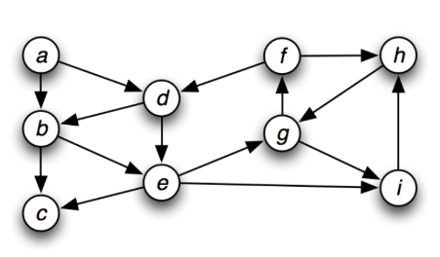
What is a Graph?
Graph G is pair (V, E) where V is a finite set (set of vertices) and E is a finite set of pairs from V (set of edges).
We generally denote n = |V| and m = |E|.
Here,
V = {a, b, …, i} and n = |V| = 9
E = {ab, bc, ad, …..} and m = |E| = 15

Slide 3
Applications of Graphs
Transportation Networks: How should you design the roads and highway network in a country? What is the quickest way to go from BRAC University to Mirpur?
Communication Networks: How to send network packet from your computer to your friend’s computer?
Social Networks: Facebook, Instagram, Twitter etc.
Dependency Networks: What courses you must take before you can take CSE470?

Slide 4
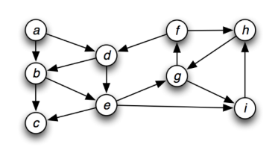
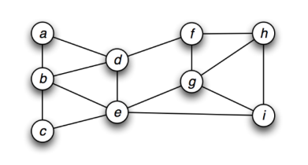
Directed vs Undirected Graphs
Graph G can be directed, if E consists of ordered pairs, or undirected, if E consists of unordered pairs.
If (u, v) Є E, then vertices u and v are adjacent.

Slide 5
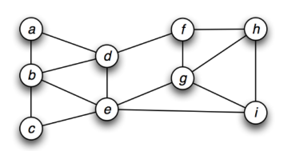
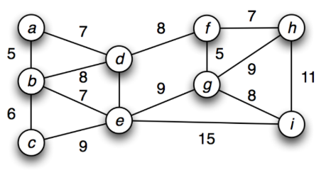
Weighted vs Unweighted Graphs
Weights can be assigned to the edges i.e. w_{G} (e) is a weight of the edge e Є E. Any graph that has such function assigned to it’s edges is called weighted graph.

Slide 6
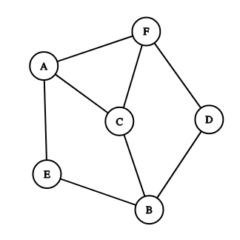
Basic Terminologies
Edges: Connections/Links between vertices (or nodes).
Here, AF, AC, BC etc. are edges of the graph.

Slide 7
Basic Terminologies
Incoming Edges: Directed edges coming into a vertex.
Here, AB and DB are two incoming edges of vertex B.

Slide 8
Basic Terminologies
Outgoing Edges: Directed edges going out of a vertex.
Here, BC and BE are two outgoing edges of vertex B.

Slide 9
Basic Terminologies
Degree: For an undirected graph, number of connected edges to a vertex v is called the degree of that vertex and is denoted by deg(v).
Vertex | deg(v)
a | 2
b | 4
c | 2
d | 4
e | 5

Slide 10
Basic Terminologies
In Degree: The number of incoming edges to a vertex v is called the in-degree of the vertex and is denoted by indeg(v).
Out Degree: The number of outgoing edges from a vertex v is called the out-degree and is denoted by outdeg(v).
Vertex | indeg(v) | outdeg(v)
a | 0 | 2
b | 2 | 2
c | 2 | 0
d | 2 | 2
e | 2 | 3

Slide 11
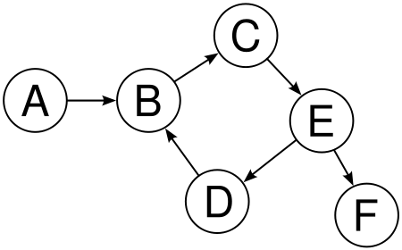
Basic Terminologies
Source Vertex: A vertex with in-degree zero. Generally, in a graph, at least one source vertex is present.
In the graph, vertex A is a source vertex.

Slide 12
Basic Terminologies
Sink Vertex: A vertex with out-degree zero.
In the graph, vertex F is a sink vertex.

Slide 13
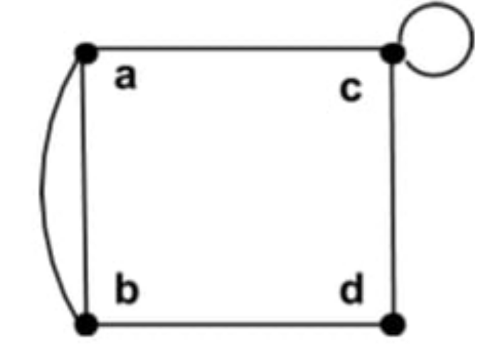
Basic Terminologies
Parallel Edges: Multiple edges between same pair of vertices.
In the graph, vertex a and b has two edges between each other i.e. they are parallel.

Slide 14
Basic Terminologies
Self Loop: An edge between the vertex and itself.
In the graph, vertex c has an edge which starts from c and ends at c i.e. a self loop.

Slide 15
Basic Terminologies
Path: A sequence of vertices connected by edge(s).
In the graph, path from A to D is (A -> B -> C -> E -> D).

Slide 16
Basic Terminologies
Cycle: A closed path where first and last vertices are the same.
In the graph, a path exists from B to B (B -> C -> E -> D -> B) which is a cycle.

Slide 17
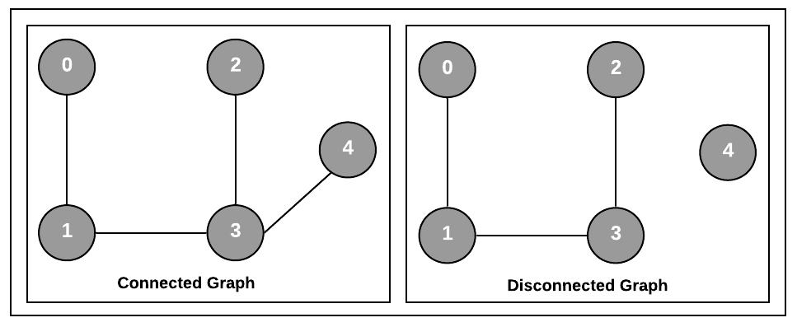
Basic Terminologies
Connected Graph: A path exists between every pair of vertices.

Slide 18
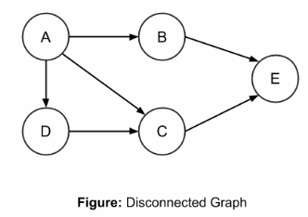
Basic Terminologies
Disconnected Graph: A path is absent between any pair of vertices.

Slide 19
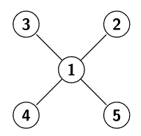
Basic Terminologies
Sparse Graph: Number of edges is considerably less than maximum number of edges.

Slide 20
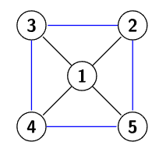
Basic Terminologies
Dense Graph: Number of edges is close to the maximum number of edges.

Slide 21
Relationship between n and m
If G is a graph with m edges, then Σdeg(v) = 2m
If G is a directed graph with m edges, then Σindeg(v) = Σoutdeg(v) = m
If G is a simple undirected graph with n vertices and m edges, then m ≤ n(n - 1)/2.
If G is a simple directed graph with n vertices and m edges, then m ≤ n(n - 1).

Slide 22
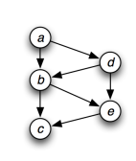
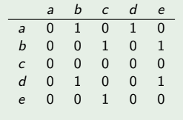
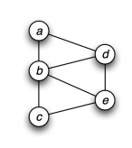
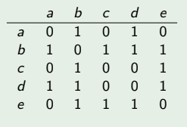
Representation of Graphs
Adjacency Matrix:
A graph G = (V, E) can be represented in an matrix of size n х n.
If (v_{i}, v_{j}) Є E, then a_{i, j} = 1 and 0 otherwise. In case of undirected graph, a_{i, j} = 1 and also a_{j, i} = 1.
Memory complexity is O(n²)
Directed Graph
Undirected Graph

Slide 23
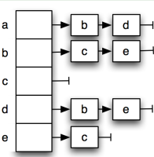
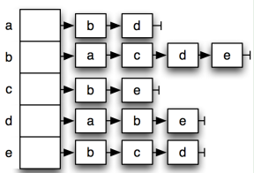
Representation of Graphs
Adjacency List:
Represents the graph by listing for each vertex v_{i}, it’s outgoing/connected vertices in a list out(v_{i}). (Can be represented using a Linked List or any other appropriate data structure)
Memory complexity is O(m + n)
Directed Graph
Undirected Graph

Slide 24
References
Mumit sir’s slide - https://drive.google.com/file/d/1OkLO91GV4M23e-1EtvFr9yeGWgk6V91q/view
PNP sir’s slide - https://docs.google.com/presentation/d/1bKKT_3Mnlp0cV509k7E8hBWEKQ_YfV0cfek10LDCo6Y/edit?slide=id.g26e6291b7d8_0_183#slide=id.g26e6291b7d8_0_183

